Slide 1
Kubernetes on Azure

Slide 2
Content
## Introduction
## Kubernetes on Azure overview
## Top scenarios
## Customer stories
## Resources

Slide 3
What is a container?
Containers
Containers
VM
VM
App1
App2
App1
App1
Binaries & libraries
Binaries & libraries
Binaries & libraries
Binaries & libraries
Guest OS
Guest OS
Virtual machines
Containers
Virtualize the hardware
Virtualize the operating system
VMs as units of scaling
Applications as units of scaling

Slide 4
Traditional virtualized environment
From dev to production agility across development and operations teams
Virtual machine
Virtual machine
Low utilization of resources
Containerization of applications and their dependencies for portability
Container
Container
Container
Container
App
App
Hypervisor
Host OS
Hardware

Slide 5
Advantages of a containerized environment
Containers are lighter weight and
faster to scale dynamically
Migrate containers and their dependencies to underutilized VMs for improved density and isolation
Virtual machine
Virtual machine
Container
Container
Decommission unused resources
for efficiency gains and cost savings
Container
Container
App
Hypervisor
Docker Engine
Host OS
Hardware

Slide 6

Secure DevOps
Deliver code faster with Kubernetes and CI/CD
Accelerate the feedback loop with constant monitoring
Balance speed and security with continuous security and deep traceability
Source code
Build
Pipelines
Release Pipelines
Kubernetes cluster
Continuous Integration
Continuous Delivery
Deployment strategies
Monitor & logging
Iterate
Monitor

Slide 7


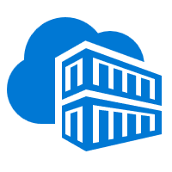

Secure DevOps
Inner loop
1
Azure Monitor
Azure DevSpaces
AKS dev cluster
sample code {
iterating.with.team
// in one
// isolated
environment
}
Test
9
</>
App telemetry
Container health
Real-time log analytics
Debug
Capabilities
8
Developers rapidly iterate, test, and debug different parts of an application together in the same Kubernetes cluster
3
2
Azure Container Registry
AKS production cluster
5
Code is merged into a GitHub repository, after which automated builds and tests are run by Azure Pipelines
Source
code control
Scan
Runtime
Azure
Policy
Container image is pushed to Azure Container Registry
Kubernetes clusters are provisioned using tools like Terraform; Helm charts, installed by Terraform, define the desired state of app resources and configurations

Release
3
Container image
Operators enforce policies to govern deployments to the AKS cluster

v1
Release pipeline automatically executes pre-defined deployment strategy with each code change
SAST
4
v2
SCA
Accept
Deny
Policy enforcement and auditing is added to CI/CD pipeline using Azure Policy
Azure Pipelines
7
CI/CD Pipelines
Helm chart
Terraform
App telemetry, container health monitoring, and real-time log analytics are obtained using Azure Monitor
Release
3
Release
N
Release
3
Release
2
Release
1
Insights used to address issues and fed into next sprint plans
6
Notes:
Seller note: The animation on this slide is very complicated. Any changes to the graphic will likely break the animation.
Open policy agent

Slide 8
Introduction

Slide 9
By 2022
75
>
%
of global organizations will be running containerized applications in production¹
¹Gartner.
Notes:
Full statistic sources
Gartner. “6 Best Practices for Creating a Container Platform Strategy.” April 23, 2019. https://www.gartner.com/smarterwithgartner/6-best-practices-for-creating-a-container-platform-strategy/

Slide 10
What’s behind the growth?
Kubernetes: the leading orchestrator shaping the future app development and management
42%
portability
45%
scalability
50%
agility
The perceived benefits of Kubernetes
Source: Cloud Native Computing Foundation

Slide 11
What’s behind the growth?
Kubernetes: the leading orchestrator shaping the future app development and management
It’s widely used
It’s vendor-neutral
It’s community-supported
Kubernetes is in production for global companies across industries¹
A variety of cloud providers
offer robust Kubernetes support
There’s a huge community of active contributors supporting Kubernetes³
Capital
One
eBay
SAP
Azure
AWS
24,000
contributors since 2016
1.1 million
contributions since 2016
New York Times
Pokémon Go
Spotify
VMWare
Red Hat
¹Kubernetes.io. “Kubernetes User Case Studies.” ²CNCF. “Kubernetes Is First…” ³CNCF. Keynote address.
Notes:
Full statistic sources
Kubernetes.io. “Kubernetes User Case Studies.” https://kubernetes.io/case-studies/
CNCF. “Kubernetes Is First CNCF Project To Graduate.” March 6, 2018. https://www.cncf.io/blog/2018/03/06/kubernetes-first-cncf-project-graduate/
CNCF. Keynote address at KubeCon CloudNativeCon Barcelona. May 21, 2019. https://www.oicheryl.com/2019/05/21/266-million-keynote-at-kubecon-cloudnativecon-barcelona/

Slide 12
Kubernetes: the industry-leading orchestrator
Portable
Public, private, hybrid, multi-cloud
Extensible
Modular, pluggable, hookable, composable
Self-healing
Auto-placement, auto-restart, auto-replication, auto-scaling

Slide 13
Kubernetes and DevOps: better together
DevOps
AKS
AKS
DevOps

Slide 14


Kubernetes on its own is not enough
Save time from infrastructure management and roll out updates faster without compromising security
Development
Platform
Unlock the agility for containerized applications using:
Infrastructure automation that simplifies provisioning, patching, and upgrading
Tools for containerized app development and CI/CD workflows
Services that support security, governance, and identity and access management
IDE container support
Security
Governance
Identity
Source code repository
Kubernetes
Registry supporting
Helm
CI/CD
Infrastructure automation
Monitoring
Virtual machines
Networking
Microservice debugging
Storage
Data

Slide 15

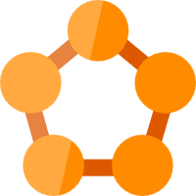
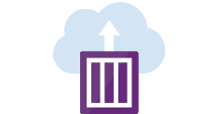

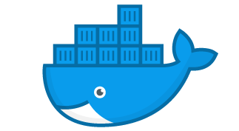



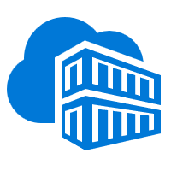
Containers in Azure
App Service
Service Fabric
Kubernetes Service
Container Instance
Container Apps
Ecosystem
Deploy web apps or APIs using containers in a PaaS environment
Modernize .NET applications to microservices using Windows Server containers
Scale and orchestrate Linux containers using Kubernetes
Elastically burst from your Azure Kubernetes Service (AKS) cluster
Fully managed serverless container service
Bring your Partner solutions that run great on Azure
Azure Container Registry
Docker Hub
Choice of developer tools and clients

Slide 16



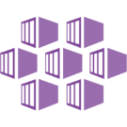
AKS and OpenShift
Build your own
Build your own
Different use-case
Build your own platform
Flexibility
Platform life cycle management
SLO (and now SLA)
Fast develop pace
Kubernetes capabilities
3th party tools
Different use-case
Commercial distributed Kubernetes
Focus on App
Secure by default
Fully supported (integrated)
SLA
Long term support
Build-in tools
Commercial distributed K8s

Slide 17
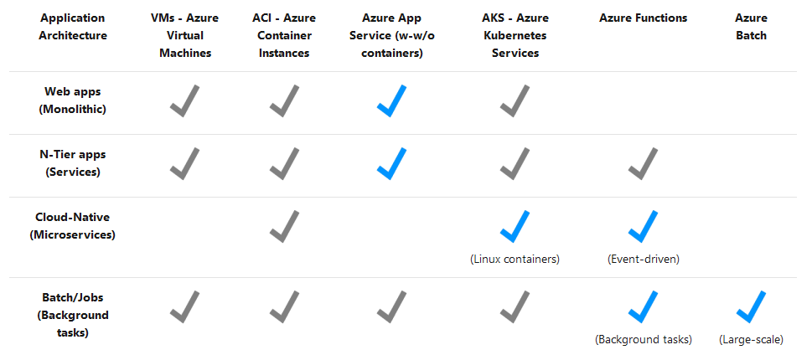

Slide 18
Kubernetes on Azure overview

Slide 19
Azure Kubernetes Service (AKS)
Ship faster, operate easily, and scale confidently with managed Kubernetes on Azure
Manage Kubernetes
with ease
Accelerate
containerized
development
Build on an
enterprise-grade,
secure foundation
Run anything,
anywhere

Slide 20


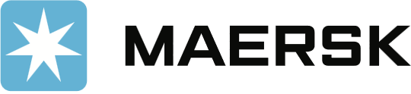


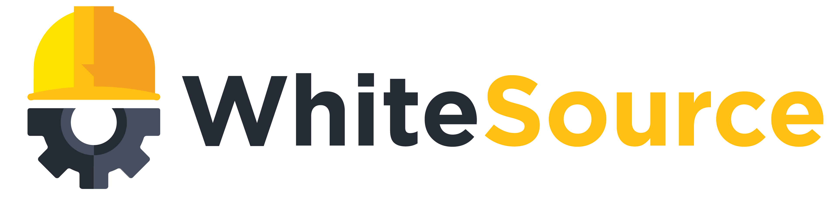











Azure Kubernetes momentum
Trusted by thousands of customers
30x
Azure Kubernetes Service
usage grew 30x since it was made generally available in June 2018
Dated November 2018

Slide 21
How Kubernetes works
Kubernetes control
Worker node
kubelet
kube-proxy
Internet
Kubernetes users communicate with API server and apply desired state
Master node
Docker
Prod
Prod
Master nodes actively enforce desired state on worker nodes
API server
Containers
Containers
Worker nodes support communication between containers
-controller-manager
-scheduler
Worker node (virtuel)
kubelet
kube-proxy
Internet
Worker nodes support communication from the
Internet
replication, namespace, serviceaccounts, etc.
etcd
Docker
Prod
Prod
Containers
Containers

Slide 22
Manage Kubernetes with ease
Infrastructure automation
Azure managed control plane
Automated provisioning, upgrades, patches
High reliability, availability
Easy, secure cluster scaling
Self-healing
API server monitoring
At no charge
App/ workload definition
Self-managed master node(s)
Kubernetes API endpoint
etcd Store
User
API server
Scheduler
Controller Manager
Cloud Controller
Schedule pods over private tunnel
Customer VMs
Docker
Docker
Docker
Docker
Docker
Pods
Pods
Pods
Pods
Pods

Slide 23
From infrastructure to innovation
Responsibilities | DIY with Kubernetes | Managed Kubernetes on Azure
Containerization
Application iteration, debugging
CI/CD
Cluster hosting
Cluster upgrade
Patching
Scaling
Monitoring and logging
Managed Kubernetes empowers you to achieve more
Focus on your containers and code, not the plumbing of them
But triggered by customer
But reboot configured by customer
But enabled by customer
Customer
Microsoft

Slide 24
Azure Kubernetes Service
Simplify the deployment, management, and operations of Kubernetes
Portable
Extensible
Self-healing
Deploy, manage, and monitor Kubernetes with ease
Accelerate
containerized app development
Roll out
new features seamlessly (CI/CD)
Secure your environment with layers of isolation
Scale applications on the fly

Slide 25
Manage Kubernetes with ease
Highly available, reliable service with serverless scaling
Azure Monitor
Azure Container
Instances (ACI)
AKS production cluster
Microservices
Pods
Serverless Kubernetes
No infrastructure to manage
Starts in seconds
Virtual node
Availability
Reliability
Auto scaling

Slide 26
Accelerate containerized development
Kubernetes and DevOps better together
Develop
Deliver
Operate
͏Develop
Native containers and Kubernetes support in IDE
Remote debugging and iteration for multi-containers
Effective code merge
Automatic containerization
Inner loop
Azure Container Registry
AKS production cluster
Source
code control
Azure DevSpaces
AKS dev cluster
Scale
Azure Monitor
Test
͏Deliver
CI/CD pipeline with automated tasks in a few clicks
Pre-configured canary deployment strategy
In depth build and delivery process review and integration testing
Private registry with Helm support
Debug
Container image
Azure Pipelines
Helm chart
Terraform
͏Operate
Out-of-box control plane telemetry, log aggregation, and container health
Declarative resource management
Auto scaling

Slide 27
Secure your Kubernetes environment with layers of isolation
Control access through
AAD and RBAC
Safeguard keys and
secrets with Key Vault
Secure network communications with
VNET and policy
Compliant Kubernetes
service with certifications
for SOC, HIPAA, and PCI

Slide 28
Scale applications on the fly
Built-in auto
scaling
Global data center
to boost performance
and reach
Elastically burst from
AKS cluster using ACI
Geo-replicated
container registry for low latency image serving

Slide 29



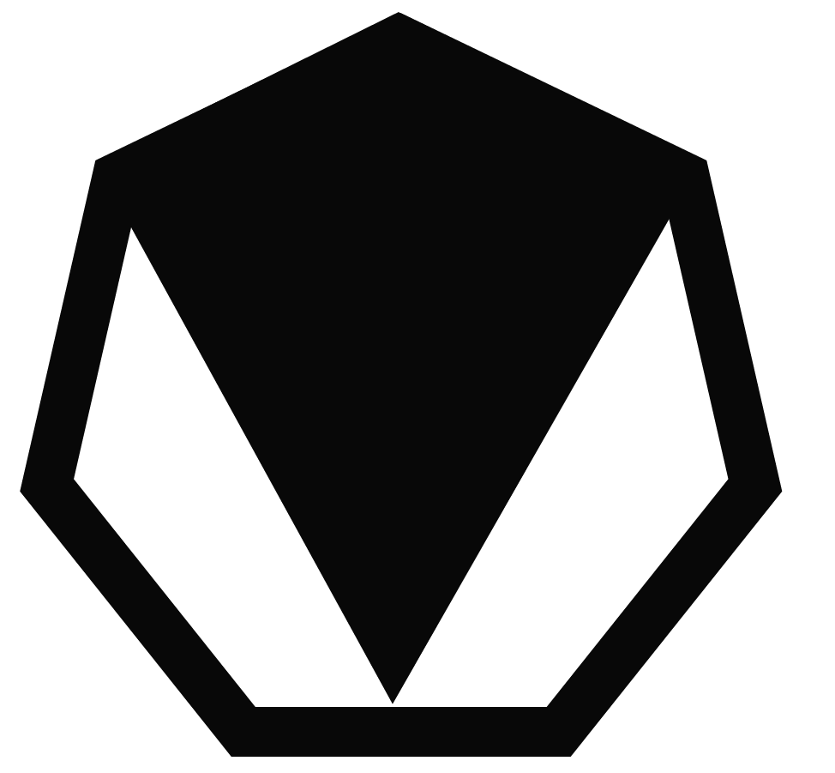



Microsoft drives community-led innovations for Kubernetes
68% of Kubernetes users* prefer Helm as their package manager
Visual Studio Code Kubernetes Extensions has 11K monthly active users
Microsoft is also the maintainer of
Cloud Native Application Bundles (CNAB) spec
Virtual Kubelet
* August, 2018 bi-annual CNCF survey

Slide 30






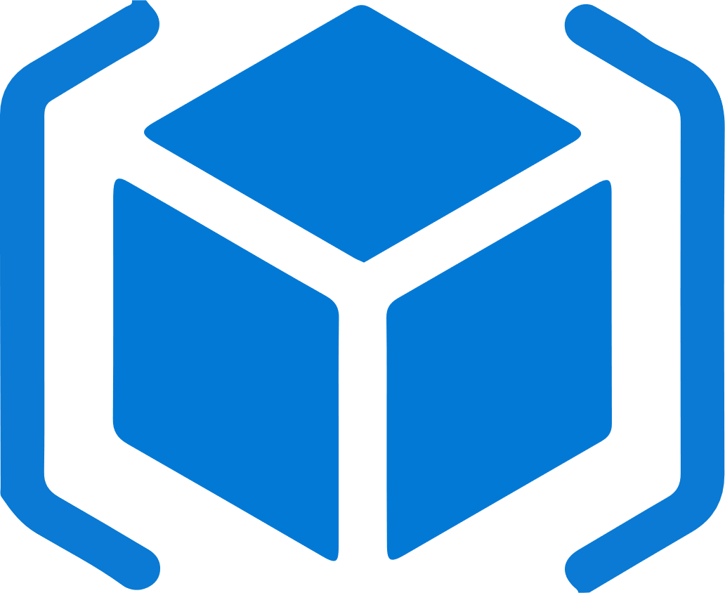
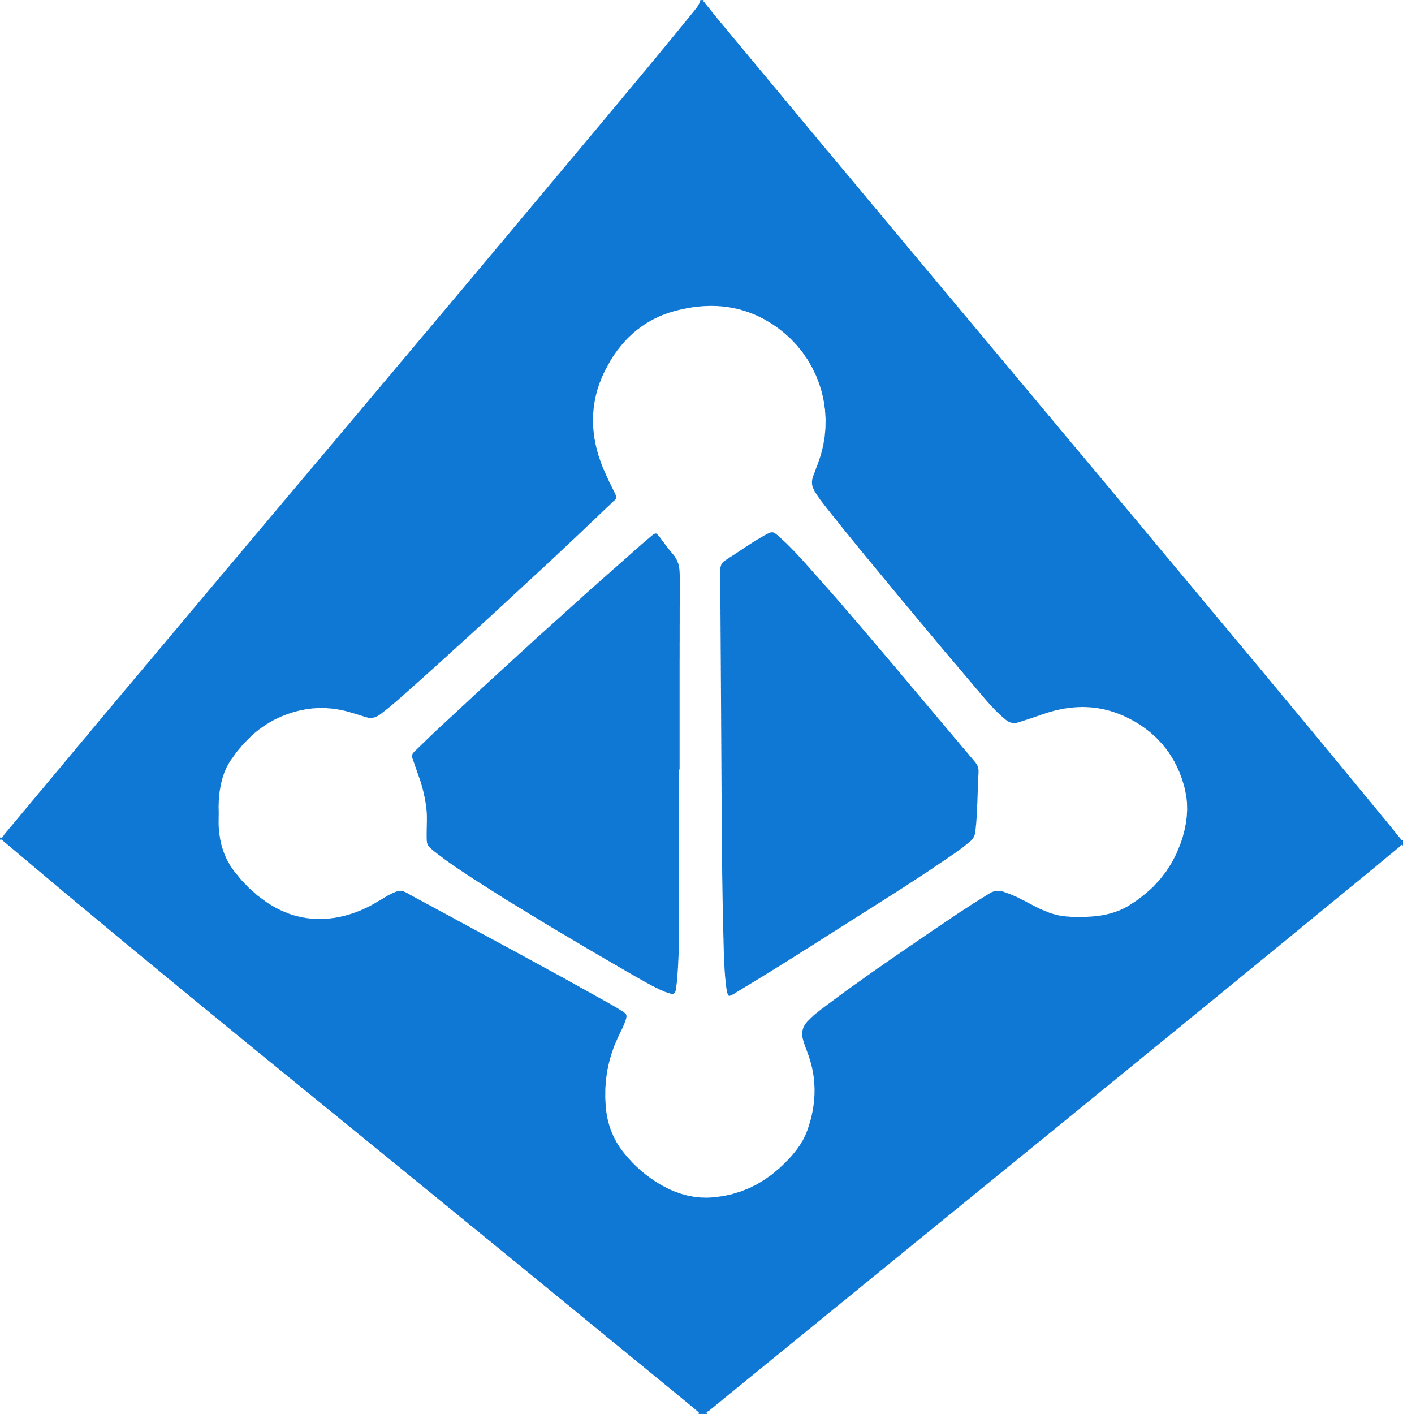

Work how you want with opensource tools and APIs
 | Development | DevOps | Monitoring | Networking | Storage | Security
Take advantage of services and tools in the Kubernetes ecosystem
Leverage 100+ turn-key Azure services
WIP. See comments.
Virtual kubelet
CNAB
DevOps
ARM
Container Registry
Azure Active Directory
Key Vault
VS Code
Azure Monitor
Azure VNET
Azure Storage
Azure Policy

Slide 31
Azure makes Kubernetes easy
Deploy and manage Kubernetes with ease
Task | The Old Way | With Azure
Create a cluster | Provision network and VMs Install dozens of system components including etcd Create and install certificates Register agent nodes with control plane | az aks create
Upgrade a cluster | Upgrade your master nodes Cordon/drain and upgrade worker nodes individually | az aks upgrade
Scale a cluster | Provision new VMs Install system components Register nodes with API server | az aks scale

Slide 32
Azure makes Kubernetes easy
Accelerate containerized application development
Task | The Old Way | With Azure
Build a containerized app and deploy to Kubernetes | Build the app Write a Dockerfile Build the container image Push the container to a registry Write Kubernetes manifests/Helm chart Deploy to Kubernetes | draft init to configure your environment draft create to auto-create Dockerfile/Helm chart draft up to deploy to Kubernetes
Inner loop development | Set up a local dev environment using Minikube Determine the transitive closure of your dependencies Identify behavior of dependencies for key test cases Stub out dependent services with expected behavior Make local changes, check-in, and hope things work Validate with application logs | Use Dev Spaces Do breakpoint debugging in your IDE
Expose web apps to the internet with a DNS entry | Deploy an ingress controller Create a load-balanced IP for it Add an ingress resource to your deployment Acquire a custom domain Create a DNS A-record for your service | Turn HTTP application routing on in your cluster Add an ingress resource to your deployment

Slide 33
Azure makes Kubernetes easy
Roll out new features seamlessly (CI/CD)
Task | The Old Way | With Azure
Set up a CI/CD pipeline and deploy to Kubernetes | Create Git repo Create a build pipeline Create a container registry Create a Kubernetes cluster Configure build pipeline to push to container registry Configure build pipeline to deploy to Kubernetes Define and set up deployment strategy | Create a project on Azure DevOps with Kubernetes/AKS as a target
Make container images available for deployment worldwide | Create a container registry in every region Configure build pipeline with multiple endpoints Loop through all regions and push following build | Create an Azure Container Registry with geo-replication Push your image to a single endpoint
Track health with consolidated cluster and application logs | Choose a logging solution Deploy log stack in your cluster or provision a service Configure and deploy a logging agent onto all nodes | Checkbox “container monitoring” in the Azure portal

Slide 34
Build on a secure, enterprise-grade platform
Control access through
AAD and RBAC
Secure network communications with
VNET and network policy
Put guardrails in your development process with Azure Policy

Slide 35

Identity
Use familiar tools like AAD for fine-grained identity and access control to Kubernetes resources from cluster to containers
Azure Storage
AKS with RBAC
Active Directory
Azure VNet
Active Directory
SQL
Database
Node
Node
Synced identity
Pod
Pod
AAD Pod Identity
Cosmos
DB
Azure
Key Vault

Slide 36
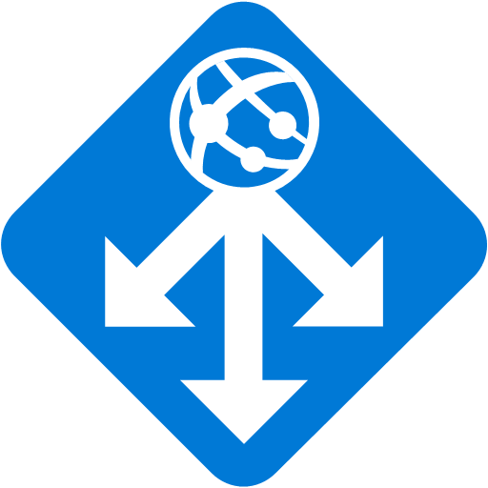
Networking
Secure your Kubernetes workloads with virtual network and policy-driven communication paths between resources
App Gateway
Kubernetes cluster: Azure VNET
Internal
Load Balancer
External
DNS
Control plane
Ingress Controller
Worker node
Worker node
kubelet
Pods
Pods
kubelet
Containers
Containers
Namespace

Slide 37

Governance
Dynamically enforce guardrails defined in Azure Policy across multiple clusters—nodes, pods, and even container images can be tracked and validated at the time of deployment or as part of CI/CD workflows
Cloud Architect
Azure Policy
Compliance reports
Assigns a policy across clusters
Cluster-1
Cluster-2
Cluster-3
Compliance reports for the entire environment, with pod-level granularity
Real-time enforcement of
policy and feedback
AKS
Developer
Cluster-1
Cluster-2
Cluster-3

Slide 38

Run anything, anywhere
Container
Region
Windows
Linux
20+ regions worldwide
Your choice of…
Environment
Public cloud
IoT
Edge
Azure
Government
Azure
Stack

Slide 39
Azure Kubernetes Service (AKS) support for Windows Server Containers
Now you can get the best of managed Kubernetes for all your workloads whether they’re in Windows, Linux, or both
Lift and shift Windows applications
to run on AKS
Seamlessly manage Windows and Linux applications through a single unified API
Mix Windows and Linux applications
in the same Kubernetes cluster—with consistent monitoring experience and deployment pipelines

Slide 40

Kubernetes is built and maintained by the community
150,000
commits
30,000
contributors
#1
GitHub project
Kubernetes collects wisdom, code, and efforts from hundreds of corporate contributors and thousands of individual contributors
Microsoft is part of this vibrant community and leads in the associated committees to help shape the future of Kubernetes and its ecosystem
CNCF
platinum member
CNCF
technical oversight committee
CNCF
governing board
Kubernetes
steering committee
Linux Foundation
board member
AKS is certified Kubernetes conformant, ensuring portability and interoperability of your container workloads

Slide 41
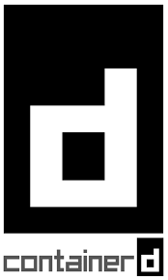
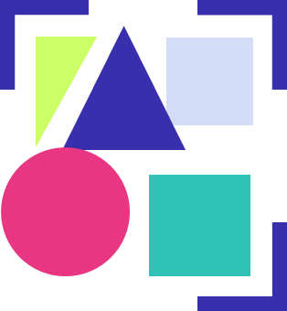









Microsoft contributions to the community
Packaging
& distribution
Containerd
CNAB
Helm
Duffle
Virtual Kubelet
Open Policy Agent
Scalability
& control
KEDA
Service Mesh Interface
Kubernetes developer tooling
Draft
VS Code Kubernetes Extensions
Brigade

Slide 42

Microsoft contributions to the community
Top
code contributor to Windows support in Kubernetes
55,000
monthly downloads of Helm
68%
of Kubernetes users prefer Helm
1 of 3
top corporate contributors
3x
growth of employee
contributors within three years
Created the Illustrated Children’s Guide to Kubernetes, now part of CNCF

Slide 43



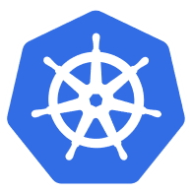





Azure Hybrid
Innovation anywhere with Azure
Microsoft Azure
Microsoft Azure
Azure Stack
Azure Arc
Azure IoT
Integrated systems
Any datacenter, any cloud
Any edge device
Management | Security + Identity | App + Data Services | Dev Tools + DevOps

Slide 44
Azure Arc
Bring Azure services and management to any infrastructure
Run Azure data
services anywhere
Extend Azure management across your environments
Adopt cloud
practices on-premises
Implement Azure
security anywhere
Azure Arc is a set of technologies that extends Azure management and enables Azure services
to run across on-premises, multi-cloud, and edge.

Slide 45
Top scenarios

Slide 46
App modernization without code changes
Lift and shift to containers
Microservices
Secure
DevOps
Machine
learning
IoT
Data
streaming
Speed application deployments by using container technology
Defend against infrastructure failures with container orchestration
Increase agility with continuous integration and continuous delivery
Kubernetes cluster
Existing application
Container Registry
CI/CD
Modernized application
Modernized application
Modernized application
Managed Database

Slide 47
App modernization without code changes
Lift and shift to containers
Microservices
Secure
DevOps
Machine
learning
IoT
Data
streaming
Capabilities
Use Azure Container Registry to store container images and Helm charts for your modernized applications, replicated globally for low latency image serving
Virtual network
Active Directory
Integrate AKS with Azure Pipelines or other Kubernetes ecosystem tooling to enable continuous integration/continuous delivery (CI/CD)
1
3
2
Azure Container Registry
Existing application
CI/CD Pipelines
Azure Database for MySQL
AKS
Enhance security with Azure Active Directory and RBAC to control access to AKS resources

Slide 48
Microservices: for faster app development
Lift and shift to containers
Microservices
Secure
DevOps
Machine
learning
IoT
Data
streaming
  Monolithic
  Microservices
  Large, all-inclusive app
  Small, independent services
Independent deployments
Improved scale and resource utilization per service
Smaller, focused teams
  App
  App
  App

Slide 49


Microservices for faster app development
Lift and shift to containers
Microservices
Secure
DevOps
Machine
learning
IoT
Data
streaming
Capabilities
4
Inner loop
Azure Container Registry
AKS production cluster
Source
code control
Pods
Azure Monitor
Use Azure Dev Spaces to iteratively develop, test, and debug microservices targeted for AKS clusters.
Dev Spaces
AKS dev cluster
Test
͏Azure Pipelines has native integration with Helm and helps simplifying continuous integration/continuous delivery (CI/CD)
Debug
1
Auto-build
2
3
͏Virtual node—a Virtual Kubelet implementation—allows fast scaling of services for unpredictable traffic.
Container instances
Pods
͏Azure Monitor provides a single pane of glass for monitoring over app telemetry, cluster-to-container level health analytics.
CI/CD Pipelines
https://github.com/Microsoft/SmartHotel360-AKS-DevSpaces-Demo

Slide 50
Secure DevOps
Lift and shift to containers
Microservices
Secure
DevOps
Machine
learning
IoT
Data
streaming
Deliver code faster with Kubernetes and CI/CD
Accelerate the feedback loop with constant monitoring
Balance speed and security with continuous security and deep traceability
Source code
Build
Pipelines
Release Pipelines
Kubernetes cluster
Continuous Integration
Continuous Delivery
Deployment strategies
Monitor & logging
Iterate
Monitor

Slide 51
Secure DevOps
Lift and shift to containers
Microservices
Secure
DevOps
Machine
learning
IoT
Data
streaming
Inner loop
1
Azure Monitor
Azure DevSpaces
AKS dev cluster
sample code {
iterating.with.team
// in one
// isolated
environment
}
Test
9
</>
App telemetry
Container health
Real-time log analytics
Debug
Capabilities
8
Developers rapidly iterate, test, and debug different parts of an application together in the same Kubernetes cluster
3
2
Azure Container Registry
AKS production cluster
5
Code is merged into a GitHub repository, after which automated builds and tests are run by Azure Pipelines
Source
code control
Azure
Policy
Container image is pushed to Azure Container Registry
Kubernetes clusters are provisioned using tools like Terraform; Helm charts, installed by Terraform, define the desired state of app resources and configurations

Release
3
Container image
Operators enforce policies to govern deployments to the AKS cluster

v1
Release pipeline automatically executes pre-defined deployment strategy with each code change
4
v2
Accept
Deny
Policy enforcement and auditing is added to CI/CD pipeline using Azure Policy
Azure Pipelines
7
CI/CD Pipelines
Helm chart
Terraform
App telemetry, container health monitoring, and real-time log analytics are obtained using Azure Monitor
Release
3
Release
N
Release
3
Release
2
Release
1
Insights used to address issues and fed into next sprint plans
6
Notes:
Seller note: The animation on this slide is very complicated. Any changes to the graphic will likely break the animation.
Open policy agent

Slide 52
Data scientist in a box
Lift and shift to containers
Microservices
Secure
DevOps
Machine
learning
IoT
Data
streaming
Algorithm
Quick deployment and high availability
Low latency data processing
Consistent environment across test, control and production
GPU-enabled VMs
Training data
AKS trained model
AI model in production
Serve the model
Data Scientist
Compute
Developer
<\>
https://github.com/Azure/kubeflow-labs

Slide 53
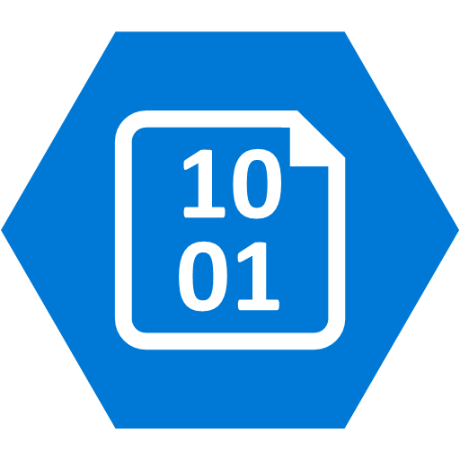
Data scientist in a box
Lift and shift to containers
Microservices
Secure
DevOps
Machine
learning
IoT
Data
streaming
App developer
6
Query the model for AI features in app
Capabilities
AKS
Package ML model into a container and publish to Azure Container Registry
ML model in containers
Azure Blob Storage hosts training data sets and trained model
1
Azure Container Registry
Use Kubeflow to deploy training job to AKS, distributed training job to AKS includes Parameter servers and Worker nodes
Data scientist
3
4
Serve the model in production
Kubeflow
Parameter
server node
Worker
nodes
GPU-enabled VMS
2
Serve production model using Kubeflow, promoting a consistent environment across test, control and production
Azure Blob Storage
5
AKS supports GPU enabled VM
Developer can build features querying the model running in AKS cluster
https://github.com/Azure/kubeflow-labs

Slide 54
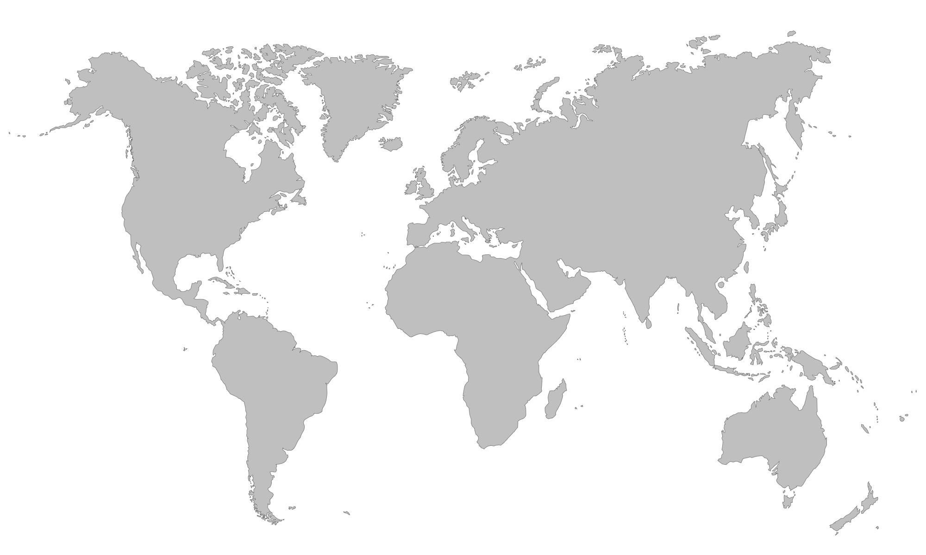

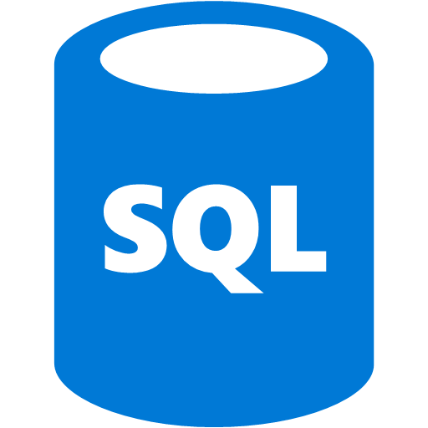

Scalable Internet of Things solutions
Lift and shift to containers
Microservices
Secure
DevOps
Machine
learning
IoT
Data
streaming
IoT Edge devices
Portable code, runs anywhere
Elastic scalability and manageability
Quick deployment and high availability
AKS
IoT Edge Connector
IoT Hub
SQL Database
Azure Cosmos DB
Database for MySQL

Slide 55
Scalable Internet of Things solutions
Lift and shift to containers
Microservices
Secure
DevOps
Machine
learning
IoT
Data
streaming
Decrypt
Decompress
Send to Storage
Compress
Encrypt
Send to Cloud
Capabilities
1
͏Azure IoT Edge encrypts data and send to
Azure, which then decrypts the data and
send to storage
Azure
Azure IoT Edge
Kubernetes cluster
2
͏Virtual node, an implementation
of Virtual Kubelet, serves as the translator between cloud and Edge
4
Node
Node
Virtual node
Docker container
Docker container
Docker container
Docker container
Docker container
3
Docker containers
IoT Edge Provider
͏IoT Edge Provider in virtual node redirects containers to IoT Edge and extend AKS cluster to target millions of edge devices
Consistent update, manage, and monitoring as one unit in AKS using single pod definition

Slide 56
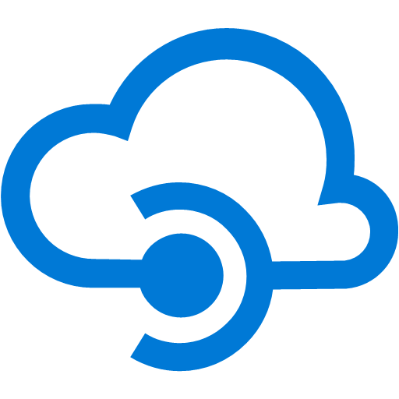


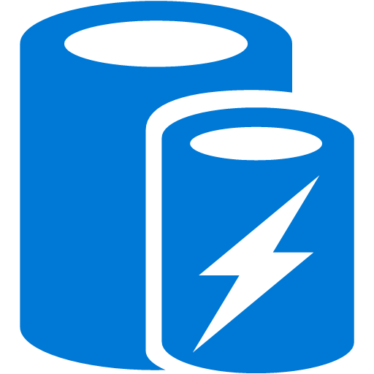
Data streaming
Lift and shift to containers
Microservices
Secure
DevOps
Machine
learning
IoT
Data
streaming
Azure Cosmos DB
AKS
API Management
Real-time data gathered and streamed to AKS
Collected data analyzed and insights generated almost instantly
Data stored and available for deeper analysis by data scientists
IoT sensor
Storage
Apache Kafka
HDInsight
Analysis
Database for PostgreSQL
Cache for Redis

Slide 57

Data streaming
Lift and shift to containers
Microservices
Secure
DevOps
Machine
learning
IoT
Data
streaming
API Management
AKS
Azure Cosmos DB
IoT sensor
3
1
2
Ingest
service
Cold path
Capabilities
Asynchronous
4
Apache Kafka
Service Mesh Interface
Service Mesh
HDInsight
͏Sensor data is generated and streamed to Azure API Management
CI/CD
Pipelines
Analysis
service
GitHub
ACR
Hot path
͏AKS cluster runs microservices that are deployed as containers behind a service mesh; containers are built using a DevOps process and stored in Azure Container Registry
Processing
service
5
͏Ingest service stores data in an Azure Cosmos DB
6
Splunk
Asynchronously, the analysis service receives the data and streams it to Apache Kafka and Azure HDInsight
Database for PostgreSQL
Cache for Redis
Data scientists can analyze the big data for use in machine learning models using Splunk
Data is processed by the processing service, which stores the result in Azure Database for PostgreSQL and caches the data in an Azure Cache for Redis
7
A web app running in Azure App Service is used to visualize the results
App Service

Slide 58
Customer stories

Slide 59

Xerox Docushare Flex—Before
Internet
Typical 3-tier
architecture using VMs
Virtual Machines
Customer A
Customer B
Customer C
Each customer instance assigned to dedicated Java and Postgres VMs
Set of backing services for authentication, file sharing, common data sources
Java
Java
Java
Postgres
Postgres
Postgres
Problem: Due to overhead and management burden of VMs, adding a new customer takes 24 hours, slowing down customer onboarding through sales and partner network
Backing Services
LDAP
SFTP
PRIZM

Slide 60
Xerox Docushare Flex—After
Internet
Typical 3-tier
architecture using VMs
AKS
Convert Postgres database to a shared backing service
Run Java application in containers with no code modification
Switch to NGINX-based web-tier with LetsEncrypt for free SSL/TLS
New Helm chart created to automate customer onboarding to AKS
Azure Container Registry
NGINX
Customer A
Customer B
Customer C
Java
Java
Java
Outcome: Run the Java application in containers on AKS, decreasing provisioning time from 24 hours to 10 minutes, accelerating sales and customer onboarding with no code changes required
Backing Services
LDAP
SFTP
PRIZM
Postgres

Slide 61


Xerox moves to containers in Azure for faster demo environment releases
“
Thanks to Azure Kubernetes Service, we can now spin up new demo environments in 10 minutes instead of 24 hours. Moving Docushare Flex from virtual machines to containers in Azure allows us to provision environments faster, empowering our sales and partner network.”
Benefits: | Onboard prospective customers faster through automation Enable self-service demo environments for large partners Reduce administrative overhead for small Ops team No code modification required
Robert Bingham, Director of DocuShare Cloud Operations, Xerox

Slide 62
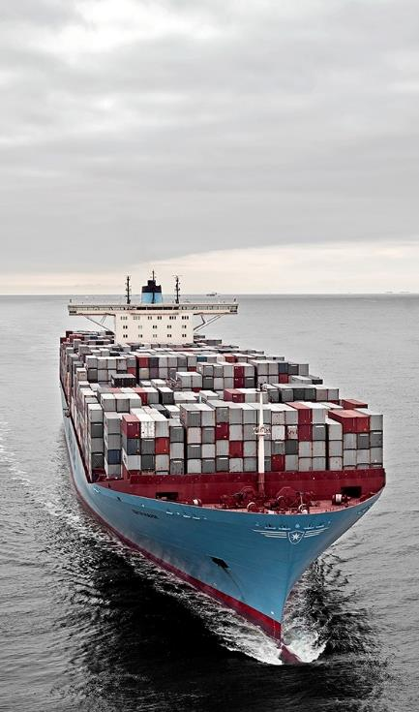

Maersk uses AKS for a customer service process to elevate NSAT, an industry-wide challenge
Needs: | Get near-real-time data to provide better customer service Collect data for future Machine Learning driven features
Challenges: | Compute & memory intensive features Data integration difficulties Limited organisational experience in Cloud & Kubernetes
Requirements: | Spend less time on container software management Automation and continuous delivery Full visibility to application, container and infrastructure Fine grained security and access control
Click icon to learn more

Slide 63

Architectural approach
Azure Pipelines for automation and CI/CD pipelines; adding Terraform for further automation
App Gateway
Firewall
Key Vault to secure secrets and for persistent configuration store
Azure Pipeline
AKS w/ RBAC
Data Factory
Data Management Gateway
On-premises database
1
4
Express
Route
Azure Monitor for containers to provide better logging, troubleshooting, with no direct container access
Key Vault
SQL Database
2
SQL Database
Cosmos DB
Azure Monitor
Event Hub
RBAC control for fine grained Kubernetes resources access control
3
Performance Document DB
App Insights
Batch processing
Event Simulation
Service Bus
Internal Queuing

Slide 64
Results
Reduced environment provisioning time from
1+ weeks to 2.5 hours
AKS and CaaS
can potentially save
33% on run cost
100% automated production
deployments
<\>
Less time spend on managing secrets with
AKS and Key Vault
Increased developer autonomy with ARM
and terraform

Slide 65
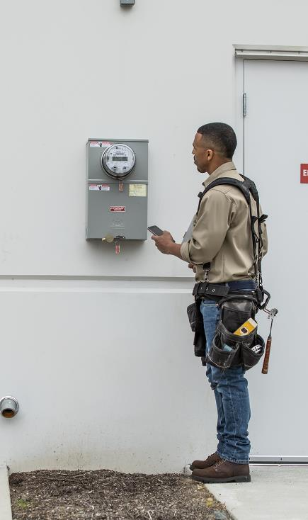

Power grid operator uses containerized software to promote smart utility initiatives
“
We are building our own new applications using microservices, and AKS is our choice for orchestrating their workloads.”
Ståle Heitmann, Chief Technology Officer
Hafslund Nett
Challenge: | Legacy systems for reading meter data needed greater capacity to process large volumes of IoT data—but implementing the necessary system enhancements was difficult and expensive
Solution: | Hafslund chose to develop its own software for processing meter data. The company used Microsoft Azure as its cloud platform, AKS to manage software containers, and Azure Monitor for containers to optimize container performance.
Outcome: | Halfslund now has a standard way to create, monitor, scale, and manage applications, which means it can respond to customer needs faster.
Click icon to learn more

Slide 66


Cloud computing supports value-based care development for medical technology provider
“
Using Azure Kubernetes Service puts us into a position to not only deploy our business logic in Docker containers, including the orchestration, but also … to easily manage the exposure and control and meter the access.”
Challenge: | Siemens Healthineers wanted to develop more of its solutions in the cloud—on-premises systems were proving complicated for data aggregation and analytics—but strict compliance requirements were making that transition tricky.
Solution: | The company selected Microsoft Azure for its cloud development platform thanks in large part to the number of regulatory certifications Azure has earned worldwide. With that decision, the company now deploys its distributed applications in Docker containers, orchestrates those containers using Kubernetes, and monitors and manages the environment with AKS.
Outcome: | AKS enables developers to quickly and easily work with their applications with minimal operations and maintenance overhead, leading to shorter release cycles and helping the company achieve its desired continuous delivery approach.
Thomas Gossler, Lead Architect, Digital Ecosystem Platform
Siemens Healthineers
Click icon to learn more

Slide 67


Ambit Energy uses cloud to electrify pace of innovation and expansion
“
Azure support for Docker, Kubernetes, Puppet, Terraform, Cassandra, and other open source tools has become very important to us and has really accelerated our move into Azure.”
Challenge: | To meet aggressive growth goals, Ambit Energy needed to automate infrastructure provisioning to match their pace of new software creation.
Solution: | To stand up infrastructure quickly, Ambit used Microsoft Azure services such as Azure Container Service, together with infrastructure as code and open source technologies, to completely automate infrastructure provisioning.
Outcome: | By implementing Azure, Ambit can move dramatically faster to enhance its services and enter new markets. Infrastructure redundancy is flexible and worry-free. And costs are 22 percent lower, which helps Ambit compete in the crowded electricity market.
Robert Rudduck, Director of Architecture and DevOps, Ambit Energy
Click icon to learn more

Slide 68

Altair Engineering uses cloud to democratize HPC access
“
Customers are limited as to what they can do on workstations, but with Azure we can give them a scalable, cost-effective back-end HPC infrastructure.”
Challenge: | Altair needed a specialized HPC architecture containing high-performance graphics processing units to deliver their latest topology optimization and analysis application to customers.
Solution: | Altair used Kubernetes in Azure Container Service to handle back-end functions and increase the density of services running across compute nodes.
Outcome: | With Azure, Altair provides customers with a scalable, cost-effective back-end HPC infrastructure, eliminating the need for expensive engineering workstations.
Sam Mahalingam, Chief Technical Officer Cloud Computing and High-Performance Computing Strategy, Altair Engineering
Click icon to learn more

Slide 69
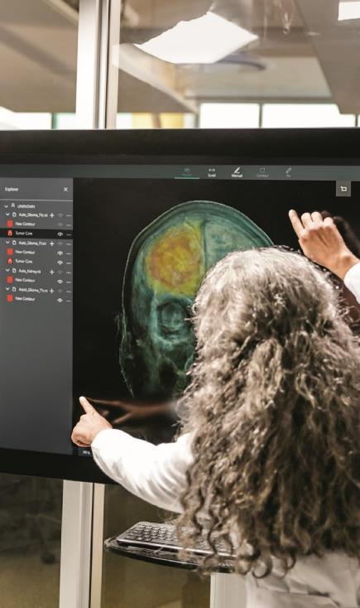

Varian uses cloud and container software technology to streamline IT and focus on innovation
“
With AKS, developers get a safe place to innovate and to experiment with new technologies and ideas…It’s the best of open service combined with the best of Azure.”
Challenge: | Varian needed to provide broader cancer care and enable faster innovation for the benefit of cancer patients.
Solution: | Varian chose Microsoft Azure as its cloud platform and Azure Kubernetes Service to scale application deployments to thousands of customers, utilizing containers to modernize existing apps and create new ones.
Outcome: | With AKS, Varian’s developers can deliver features to customers quickly and get their feedback without the overhead of provisioning a group of virtual machines.
Shivakumar Gopalakrishnan
Senior Manager, Varian Medical Systems
Click icon to learn more

Slide 70

Falkonry uses cloud and machine learning to create a “data scientist in a box”
“
We’re very happy with the speed of deployment we can offer our customers
with Azure. If we had to fly people out to configure and set up hardware and software, we would lose several weeks in the process.”
Challenge: | Falkonry needed a solution to scale the deployment of its machine learning application to reach customers in the oil and gas industries.
Solution: | Falkonry used Azure Kubernetes Service to automate the deployment of Kubernetes clusters to deliver their application globally.
Outcome: | With Azure Kubernetes Service, Falkonry is able to deploy their solutions in days, compared to months it takes for companies using a more traditional platform approach.
Sanket Amberkar, Senior VP of Marketing, Falkonry
Click icon to learn more

Slide 71

OpenAI uses cloud to drive flexibility and scalability for deep learning experiments
“
Because Kubernetes provides a consistent API, we can move our research experiments very easily between clusters… [We] have a number of teams that run their experiments both in Azure and in our own data centers, just depending on which cluster has free capacity, and that's hugely valuable.”
Challenge: | OpenAI needed infrastructure for deep learning that would allow experiments to run either in the cloud or in its own data center, and to easily scale.
Solution: | OpenAI migrated its Kubernetes clusters to Azure, running key experiments in fields including robotics and gaming both in Azure and in its own data centers.
Outcome: | Researchers now spend far less time launching experiments and scaling them out to hundreds of GPUs. OpenAI has also benefited from greater portability and lower costs given the ability to use its own data centers when appropriate.
Christopher Berner, Head of Infrastructure, OpenAI
Click icon to learn more

Slide 72
Kubernetes and OpenShift

Slide 73
AKS and OpenShift
Build your own
Build your own
Different use-case
Build your own platform
Flexibility
Platform life cycle management
SLO
Fast develop pace
Kubernetes capabilities
3th party tools
Different use-case
Commercial distributed Kubernetes
Focus on App
Secure by default
Fully supported (integrated)
SLA
Long term support
Build-in tools
Commercial distributed K8s

Slide 74
Compete

Slide 75
How to compete?
AWS
EKS
GPC
GKE
Feature
Breadth of service
Never do a feature compare
We stronger ☺
Getting There
Azure Core strategic application platform
¹CNCF. ²Microsoft..
Notes:
Full statistic source for 68%: https://www.cncf.io/blog/2018/08/29/cncf-survey-use-of-cloud-native-technologies-in-production-has-grown-over-200-percent/

Slide 76
Resources

Slide 77






Best support for your enterprise need
Learning path
aka.ms/LearnKubernetes
What is Kubernetes
aka.ms/k8sLearning
Hear from experts
aka.ms/AKS/videos
Case studies
aka.ms/aks/casestudy
See what’s new
aka.ms/k8s/roadmap
Try for free
aka.ms/aks/trial
Feedback on the roadmap? Tell us at https://aka.ms/aks/feedback

Slide 78
Product deep dive

Slide 79
Horizontal Pod Autoscaler
The horizontal pod autoscaler (HPA) uses the Metrics Server in a Kubernetes cluster to monitor the resource demand
of pods. If a service needs more resources, the number of pods is automatically increased to meet the demand.
͏HPA obtains resource metrics and compares them to user-specified threshold
2
Node1
Horizontal
Pod Autoscaler
Pod
3
Deployment
ReplicaSet
͏HPA evaluates whether user specified threshold is met or not
replicas++
Kubelet
replicas--
4
cAdvisor
Pod
͏HPA increases/decreases the replicas based on the specified threshold
Grabs
metrics
1
NodeX
͏The Deployment controller adjusts
the deployment based on increase/decrease in replicas
Metrics
Server
Node2
Pod
Collects metrics from all containers on the node
Kubelet
Collects metrics from all nodes
cAdvisor

Slide 80
Cluster Autoscaler
The cluster autoscaler watches for pods that can't be scheduled on nodes because of
resource constraints. The cluster then automatically increases the number of nodes.
͏HPA obtains resource metrics and compares them to user-specified threshold
Cluster
Autoscaler
Azure
Pod
Pod
2
1
͏HPA evaluates whether user specified threshold is met or not
Additional
nodes needed
Pods are in
pending state
͏HPA increases/decreases the replicas based on the specified threshold
3
Pending pods
are scheduled
Node is granted
4
͏The Deployment controller adjusts
the deployment based on increase/decrease in replicas
AKS cluster
Node
Node
Pod
Pod
Pod
Pod

Slide 81

Azure Pipelines for AKS
Deep traceability
3
͏As part of the CI, developers check in their code to a central repository; Azure pipelines automatically build application binaries, run unit test, and push container image into a registry
Source Repository
Container image
Pod
͏Developers then deploy the application to a testing environment and run integration test as part of the CD workflow
͏Developers can review which pod is running which container image, what source code is built into an image, and what tests are run against each image at any point of time
Source code
Azure Pipelines Build
Azure Pipelines Release
AKS cluster
1
2
4
Continuous Integration
Continuous Delivery
Deploy strategies
͏For production deployment, Azure Pipelines automatically execute pre-defined deployment strategy and progressively roll out application to
an AKS cluster
Azure
Monitor
͏Enable app telemetry, container health monitoring, and real-time log analytics; insights used to address issues and feed into next sprint plans
Iterate
5
Monitor

Slide 82
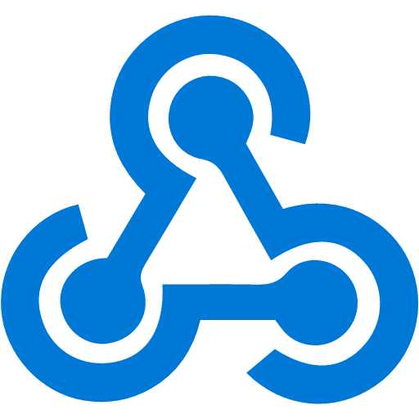
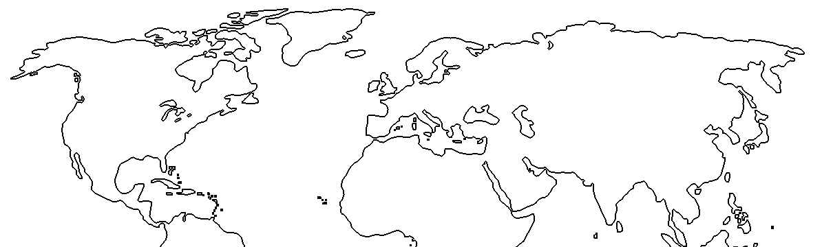
Azure Container Registry geo-replication
Push image to a single registry and ACR takes care of geographical replication, including local notifications.
Container image
Developer
͏US-based developer commits codes to build container image
1
</>
Image is pushed to the nearest Azure Container Registry (ACR) region based on DNS
3
5
East US
contoso.azurecr.io
contoso.azurecr.io
West Europe
2
͏Geographical webhook triggers deployment to
East US
AKS
CD
ACR
ACR
CD
AKS
͏ACR geo-replicates to configured regions
Geo-Replication
͏Geographical webhook triggers deployment to West Europe
contoso.azurecr.io/app:v1
4
contoso.azurecr.io/app:v1
6
6
͏Both AKS clusters pull from contoso.azurecr.io

Slide 83
Serverless Kubernetes using AKS virtual nodes
Elastically provision compute capacity
in seconds
No infrastructure to manage
Built on open sourced Virtual Kubelet
technology, donated to the Cloud Native
Computing Foundation (CNCF)
Node
Node
Pods
Pods
Fargate
Kubernetes control plane
Pods
Virtual node

Slide 84
Kubernetes-based event-driven auto-scaling (KEDA)
Open-source component jointly built by Microsoft and RedHat
Event-driven container creation & scaling
Allows containers to “scale to zero” until an event comes in, which will then create the container and process the event, resulting in more efficient utilization and reduced costs
​Native triggers support
Containers can consume events directly from the event source, instead of routing events through HTTP
​Can be used in any Kubernetes service
This includes in the cloud (e.g., AKS, EKS, GKE, etc.) or on-premises with OpenShift—any Kubernetes workload that requires scaling by events instead of traditional CPU or memory scaling can leverage this component.
Kubernetes cluster
Scaler
AKS cluster
External
trigger source
Controller
Metrics adapter
KEDA

Slide 85



Service Mesh Interface (SMI)
Apps
Tooling
Ecosystem
SMI defines a set of APIs that can be implemented by individual mesh providers. Service meshes and tools can either integrate directly with SMI or an adapter can consume SMI and drive native mesh APIs.
​Standard interface for service mesh on Kubernetes​
​Basic feature set to address most common scenarios​
​Extensible to support new features as they become widely available​
Service Mesh Interface
Routing
Telemetry
Policy
…and more
Kubernetes

Slide 86

Security overview
Internal User
External User
Azure Container Registry
App Gateway
Developer
AKS with RBAC
͏Image and container level security
AAD authenticated Container registry access
ACR image scanning and content trust for image validation
1
Internal
Load Balancer
External
Load Balancer
͏Node and cluster level security
Automatic security patching nightly
Nodes deployed in private virtual network subnet w/o public addresses
Network policy to secure communication paths between namespaces (and nodes)
Pod Security Policies
K8s RBAC and AAD for authentication
Azure VNet
Active Directory
Ingress Controller
Ingress Controller
External DNS
Kubernetes Admin
Node
Node
Pod
Pod
3
2
͏Pod level security
Pod level control using AAD Pod Identity
Pod Security Context
AAD Pod Identity
Azure
Key Vault
4
͏Workload level security
Azure Role-based Access Control (RBAC) & security policy groups
Secure access to resources & services
(e.g. Azure Key Vault) via Pod Identity
Storage Encryption
App Gateway with WAF to protect against threats and intrusions
Azure Storage
SQL Database
Cosmos DB
Encrypted Storage

Slide 87
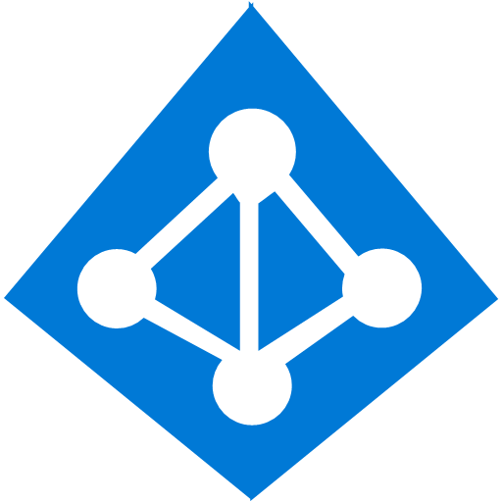
Pod identity
Developer
Kubernetes operator defines an identity map for K8s service accounts
<\>
Node Managed Identity (NMI) watches for mapping reaction and syncs to Managed Service Identify (MSI)
3
Kubernetes
Kubernetes controller
Azure Identity Binding
Azure SQL Server
Developer creates a pod with
a service account, and pod uses standard Azure SDK to fetch
a token bound to MSI
1
Pod
Pod uses access token to consume other Azure services; services validate token
Active Directory Pod Identity
Token
Azure MSI
4
NMI + EMSI
2

Slide 88
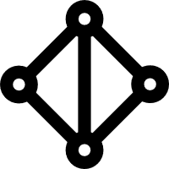
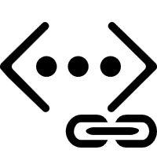
Secure network communications with VNET and CNI
Uses Azure subnet for both your containers and cluster VMs
1
On-premises infrastructure
3
Azure VNet A
Enterprise system
Allows for connectivity to existing Azure services in the same VNet
Backend
services subnet
AKS subnet
Azure
Express
Route
AKS cluster
SQL Server
Use Express Route to connect to on-premises infrastructure
Azure SQL PaaS DB
5
Use VNet peering to connect to other VNets
2
Service Endpoint
Connect AKS cluster securely and privately to other Azure resources using VNet endpoints
VNet peering
Other peered VNets
4
AKS VNet integration works seamlessly
with your existing network infrastructure

Slide 89
Identity and access management through AAD and RBAC
A developer authenticates to the AAD token issuance endpoint and requests an access token
Azure Active Directory
The AAD token issuance endpoint issues the access token
1
The access token is used to authenticate to the secured resource
Developer
Token
2
AKS
Data from the secured resource is returned to the web application
3
Token
4
Azure delivers a streamlined identity and access management solution with Azure Active Directory (AAD) and Azure Kubernetes Services (AKS)

Slide 90
Azure Policy for clusters
Cloud architect assigns a deployment policy across cluster(s)
Cloud Architect
Azure Policy
Developer uses standard Kubernetes API to deploy to the cluster
1
Real-time deployment enforcement (acceptance/denial) provided to developer based on policy
Compliance reports
4
Cluster-1
Cluster-2
Cluster-3
Cloud architect obtains compliance report for the entire environment and can drill down to individual pod level
AKS
Developer
3
Cluster-1
Cluster-2
Cluster-3
2

Slide 91
Azure Pipelines build audit & enforcement using Azure Policy
Cloud architect assigns a policy across clusters; policy can be set to block non-compliance (deny) or generate non-compliance warnings (audit)
Cloud Architect
Azure Policy
1
Developer makes code change that kicks off an Azure Pipelines build
Azure Pipelines evaluates the request for policy compliance
Azure Pipelines
4
Yes
Deny policy
No
If policy is set to deny, Azure Pipelines rejects the build attempt if any non-compliance is identified
Developer
Fail
5
Compliance check
AKS
2
3
If policy is set to audit, a non-compliance event is logged and the build is allowed to proceed
Cluster-1
Cluster-2
Cluster-3
Pass

Slide 92
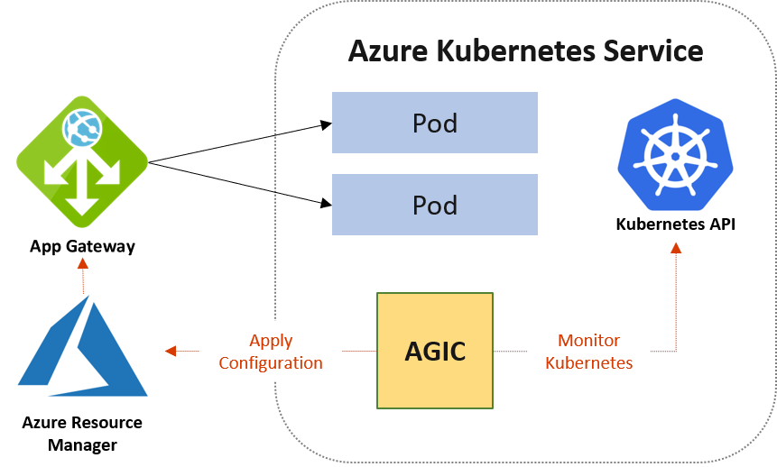
Azure Application Gateway Ingress Controller (AGIC)
Fully managed Ingress Controller
Ingress Controller is supported exclusively by Standard_v2 and WAF_v2 SKUs, which also brings you autoscaling benefits. Application Gateway can react in response to an increase or decrease in traffic load and scale accordingly, without consuming any resources from your AKS cluster.
Native Application Gateway L7 load balancer:
- URL routing
- Cookie-based affinity
- SSL termination
- End-to-end SSL
- Support for public, private, and hybrid web sites
- Integrated web application firewall

Slide 93

Azure Monitor for containers
Visualization
Visualize overall health and performance from clusters to containers with drill downs and filters
Observability
Insights
Provide insights with multi-cluster health roll up view
Azure Pipelines
Kubernetes control
Azure Monitor for containers
Monitor & Analyze
Monitor and analyze Kubernetes and container deployment performance, events, health, and logs
NEW!
Response
Native alerting with integration to issue managements and ITSM tools
ACI
Observability
Observe live container logs on container deployment status

Slide 94
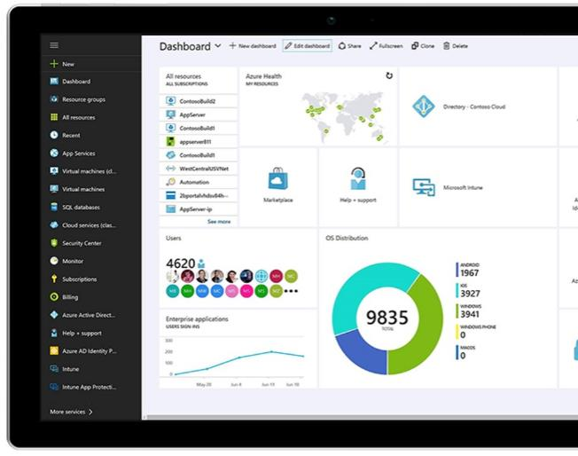
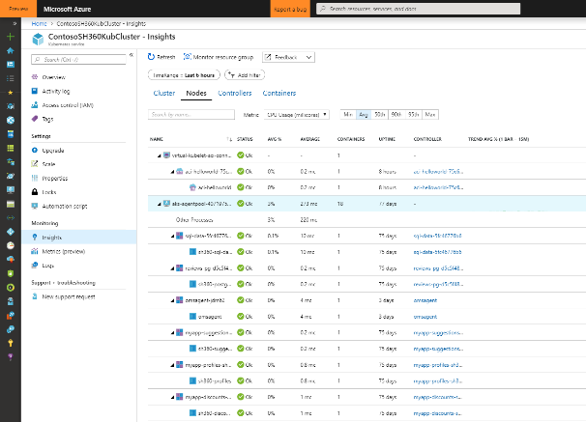
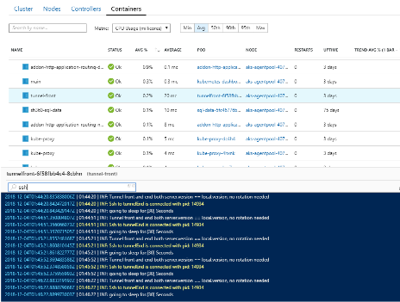
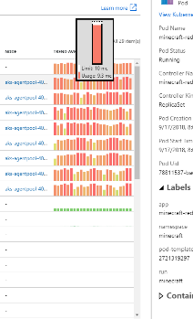
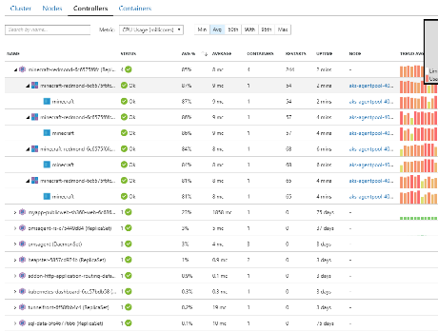
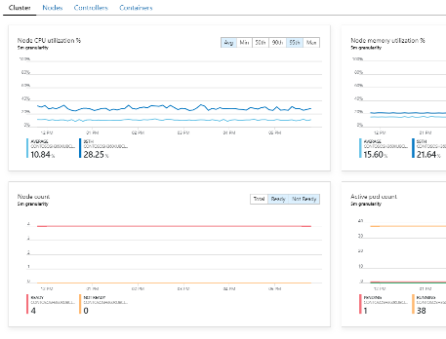
Azure Monitor for containers
1
2
3
4
Get detailed insights about your workloads with Azure Monitor
See graphical insights about clusters
Filter for details about nodes, controllers, and containers
Pull events and logs for detailed activity analysis

Slide 95
Thank you.

